Slide 1
WORD EMBEDDING
SHUBHAM NAIK
SOFTWARE ENGINEER | SYNTEL PVT LTD,PUNE
DATA SCIENCE, ML ENTHUSIAST
naikshubham55@gmail.com

Slide 2
Word Embedding
Before we start lets have a look at below examples:
You open google and search for ongoing FIFA WorldCup and get hundreds of search results.
Nate Silver analysed millions of tweets and correctly predicted the results of 49 out of 50 states in 2008 U.S Presidential Elections.
You type a sentence in google and say translate in chinese, you will get equivalent Chinese conversion.
So what do you find common in the above examples?

Slide 3
Text processing
All of the above scenarios deal with huge amount of text to perform different task like :
Clustering in google search example
Classification in the second
Machine translation in the third
Humans can do the above task but while millions of documents being generated daily, its not feasible nor effective.
So , how do we tell computers to perform above tasks such as clustering, classification, etc on text data ,as we know that computers can deal with numbers and not text.

Slide 4
Word Embedding
Computers can compare two strings and tell us whether they are same or not.
But how do we make computer tell us about football or Ronaldo when we search for Messi.
Suppose we have a sentence “Apple is a tasty fruit”.
How do we make computers understand that “Apple” in the above sentence is a fruit to be eaten and not a company.
All these can be achieved by creating a representation of words that capture their meanings, semantic relationship etc.
All of these are implemented by using Word Embeddings.

Slide 5
Word Embedding
Why do we need word embedding?
Many machine learning algorithms and almost all deep learning architectures are incapable of processing strings or plain text in their raw form.
They require numbers as input.
Word Embedding is a technique of converting text into numerical representation.

Slide 6
Different types of Word Embeddings
Word Embeddings can be classified into below categories
One hot encoding
Frequency based Embedding
Prediction based Embedding

Slide 7
One hot encoding
Consider below dataset, we need to create a model to predict the heights
We need to convert the haircolor into numeric values.
Option 1: Integer encoding – Give a number to each of them.
Weight | Hair Color | Counrty | Height
75 | Black | India | 180
65 | Brown | US | 150
80 | Red | Canada | 190
77 | Golden | UK | 175
70 | Grey | China | 170
Black | Brown | Red | Golden | Grey
1 | 2 | 3 | 4 | 5

Slide 8
Integer encoding
But numbers have a order. By converting hair colors into numbers we are creating artificial order which is not correct.
e.g 3>2 , but Red > Brown is incorrect.
Option 2: One hot encoding ,which is a better strategy.
One hot encoding converts categorical features into binary vectors.

Slide 9
One hot encoding
One hot encoding creates a binary vector which has the size of number of distinct values.
So we will have vectors like:
Black
Brown
Red
And So on
Black | Brown | Red | Golden | Grey
1 | 0 | 0 | 0 | 0
Black | Brown | Red | Golden | Grey
0 | 1 | 0 | 0 | 0
Black | Brown | Red | Golden | Grey
0 | 0 | 1 | 0 | 0

Slide 10
Disadvantage of one hot encoding
Country column can have 200 distinct values.
So the dimension of binary vector will increase, as the dimension of binary vector is the number of distinct values.
If the number of distinct values for a categorical feature is large then One hot encoding can create large and sparse vectors.
Country 1 | Country2 | Country 3 | ……. | ……. | …… | …… | ……. | …… | Country 200

Slide 11
Imputing Country Column by mean replacement
Our objective is to predict height.
Replace country names in country column by average heights of people from that country.
This way we have converted categorical names into numeric vectors.
This are problem specific solutions.

Slide 12
Frequency Based Embedding
Below are frequency based embedding techniques
Bag of Words (Count Vector)
TF – IDF
Uni-gram/Bi-gram/Tri-gram/n-grams

Slide 13
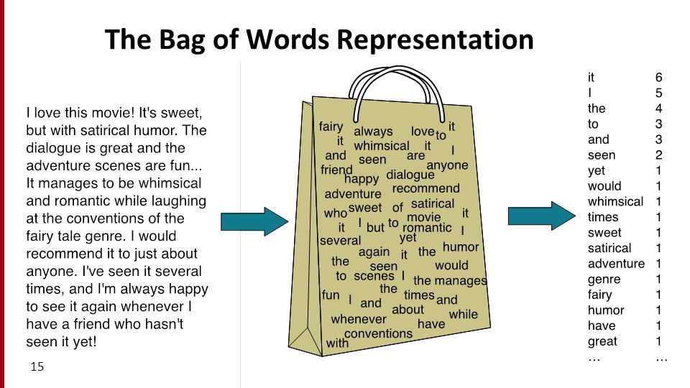
Bag of Words (BoW)
BoW is a technique used to convert text to vector.

Slide 14
Why convert text to vectors?
Once text is converted to vector we can leverage the whole power of linear algebra.
Machine learning algorithms cannot work with raw text directly , the text must be converted to numbers.
A problem with text is that it is messy and techniques like machine learning algorithms require well defined fixed-length inputs and outputs.

Slide 15
Let’s create a Bag of Words model
Consider below are reviews for a food product(pasta) on amazon.
Review 1: This pasta is very tasty and affordable.
Review 2: This pasta is not tasty and affordable.
Review 3: This pasta is delicious and cheap.
Review 4: Pasta is tasty and pasta tastes good.
Now task at hand is to classify whether the Review is positive or negative using Machine Learning Algorithm.

Slide 16
Step 1: Design the vocabulary ->Set of all unique words in the Reviews(ignoring punctuations)
Below will be the Dictionary of all the unique words:
{'affordable', 'very', ‘pasta', 'good', 'tastes', 'tasty', 'not', 'delicious',
'cheap', 'is', 'and', this'}
Text is called Document in NLP(Natural Language Processing)

Slide 17
Step 2: Create Document Vectors
Next step is to count the frequency of words in each document(text).
Objective is to convert each document(text) into vector that we can use as input or output to a machine learning model.
Below is our Document Corpus
Now create Document Vector for each document(Review text ) by simply marking the frequency of words against the words in document corpus.
affordable | very | pasta | good | tastes | tasty | not | delicious | cheap | is | and | This

Slide 18
Creating Document Vectors.
Review 1: “This pasta is very tasty and affordable.”
This is how we construct document vector.
“This pasta is very tasty and affordable”= [1,1,1,0,0,1,0,0,0,1,1,1]
“This pasta is not tasty and affordable” = [1,0,1,0,0,1,1,0,0,1,1,1]
“This pasta is delicious and cheap” = [0,0,1,0,0,0,0,1,1,1,1,1]
“Pasta is tasty and pasta tastes good” = [0,0,2,1,1,1,0,0,0,1,1,0]
Such vectors having lot of zeros are called Sparse Vectors.
affordable | very | pasta | good | tastes | tasty | not | delicious | cheap | is | and | This
1 | 1 | 1 | 0 | 0 | 1 | 0 | 0 | 0 | 1 | 1 | 1

Slide 19
Similarity of vectors
Review 1: This pasta is very tasty and affordable.
V1=
Review 2: This pasta is not tasty and is affordable.
V2=
To obtain similarity of vectors we subtract the two vectors.
Length(V1 – V2) =||V1 – V2||=sqrt(1^2 + 1^2) = sqrt(2)=1.414
Although the two reviews have completely different meaning(very tasty) and (not tasty) ,semantic English meanings are different, still the distance is between the vectors is very small.
affordable | very | pasta | good | tastes | tasty | not | delicious | cheap | is | and | This
1 | 0 | 1 | 0 | 0 | 1 | 1 | 0 | 0 | 1 | 1 | 1

Slide 20
Managing Vocabulary
As vocabulary size increases ,the vector size also increases.
If we have thousands of Reviews then our Document Corpus will have thousands or millions of words, and accordingly the length of our document vectors will be thousands or millions.
We need to decrease the size of vocabulary when using BOW model.
We can use simple text cleaning techniques such as:
Ignoring case
Ignoring punctuation
Removing stopwords such as “a” “of” “and” etc
Fixing misspelled words.
Reducing words to their stem (e.g. “play” from “playing”) using stemming algorithms.

Slide 21
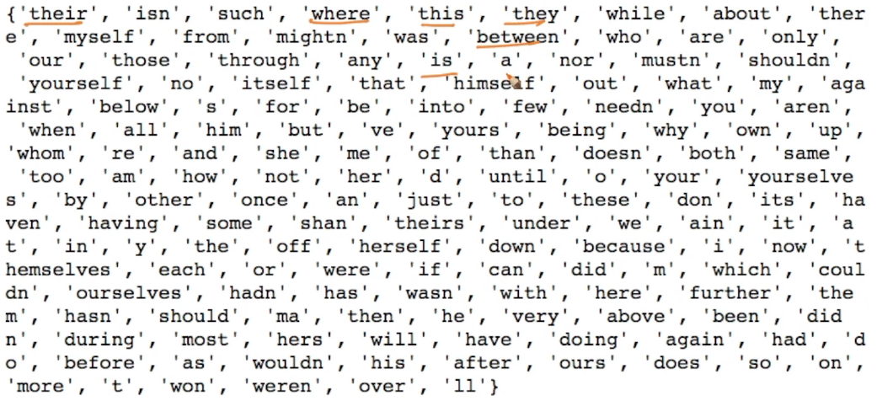
Stopwords in English
If we remove stopwords ,we wil have smaller and meaningful vectors.

Slide 22
Uni –Gram/Bi-gram/n-gram
We saw that (not,is,and,this,very) are stopwords and if we remove this stopwords from our Reviews then reviews will be exactly the same.
Review 1: This pasta is very tasty and affordable.
Review 2: This pasta is not tasty and is affordable.
After removing stopwords vectors V1 and V2 are exactly the same, which is not true.
To overcome this we use Bi-gram and Tri-gram.

Slide 23
Uni –gram ,Bi-grams
In uni-gram each word is considered a dimension.
In Bi-grams pairs of consecutive words are considered a dimension.
Our Document Corpus for Bi-grams will be:
Review 1: “This pasta is very tasty and affordable.”
This way we can maintain the semantics of the sentence.
this pasta | pasta is | is not | not tasty | is very | very tasty | tasty and | and is | is affordable | and affordable
this pasta | pasta is | is not | not tasty | is very | very tasty | tasty and | and is | is affordable | and affordable
1 | 1 | 0 | 0 | 1 | 1 | 1 | 0 | 0 | 1

Slide 24
Tri-grams and n-grams
In Tri-gram we take 3 consecutive words.
In n-gram we take n –consecutive words.
Advantage:
It retains the sequence information.
Disadvantage:
is that the number of dimensions increases with increase in n.
No of tri-grams > No of bi-grams > No of uni-grams

Slide 25
Code for BOW
Lets write and understand a code for BOW.

Slide 26
TF – IDF
TF – term frequency
IDF – Inverse Document Frequency
Consider below BOW representation:
R1 : w1,w2,w3,w2,w5
R2 : w1,w3,w4,w5,w6,w2
W1 | W2 | W3 | W4 | W5 | W6
1 | 2 | 1 | 0 | 1 | 0
W1 | W2 | W3 | W4 | W5 | W6
1 | 1 | 1 | 1 | 1 | 1

Slide 27
Term frequency
Term frequency is always computed for a word and a given document.
TF(Wj,Di)= (no of times Wj occurs in document Di)
(no of words in Document Di)
TF(W2,D1) = 2/5 = 0.4

Slide 28
Inverse Document Frequency (IDF)
D = Document corpus ( Contains all the documents)
Document corpus
R1: ----W1----
R2:
R3:------w1----
R4:
R5:-------w1---
.
..
.
.
.
Rn:

Slide 29
IDF formula
IDF(Wj , D) = log{(no of documents in D) (no of documents in D that contains Wj)}
If Wj is frequent word ,then its IDF will be low.
If Wj is rare word, then its IDF will be high.
As per research papers log is taken in relation to Zipf’s law, which is a part of research.

Slide 30
TF-IDF vector
Product of TF & IDF of word is used in the vector.
W1 = TF(W1,D1) * IDF(W1,D)
Similarlily ,we calculate TF-IDF values for all words and form a vector.
In BOW we insert number of occurrences of Word(Wi) in Document(Di).
W1 | W2 | W3 | W4 | W5 | W6
TF(W1,D1) * IDF(W1,D) | TF(W2,D1) * IDF(W2,D) | TF(W3,D1) * IDF(W3,D) | TF(W4,D1) * IDF(W4,D) | TF(W5,D1) * IDF(W5,D) | TF(W6,D1) * IDF(W6,D)

Slide 31
TF-iDF Pros and Cons
Advantages:
We give more importance to rarer words in Document corpus.
Also we give more importance to frequent words to in a Document.
Disadvantages:
TF-IDF still doesn’t take the semantic meaning of words.

Slide 32
Code for TF - IDF
Let’s understand TF – IDF with the help of a code.

Slide 33

Prediction based Embedding

Slide 34
Word2Vec
Word2Vec is a Neural Network structure.
It was developed by Tomas Mikolov at Google in 2013.
There are two algorithms to achieve Word2vec
Word2Vec
CBOW
Skip Gram

Slide 35
Word2Vec
Word2Vec is a text to vector conversion technique which takes semantic meaning of words into consideration.
BOW and TF-IDF doesn’t take semantic meaning of words into consideration.
Word2Vec converts a word into d-dimensional vector, d is typically 50,100,200,300.
Suppose we have 3 words:
W1 = tasty ,W2 =delicious,W3=baseball
If we create vectors for this words using Word2Vec
W1 → V1 , W2→ V2 , W3 → V3
Since Word2Vec takes semantic meanings of words into consideration vectors V1 and V2 will be closer as compared to V1 and V3 or V2 and V3.

Slide 36
Continous Bag of Words (CBOW)
Consider a sentence : “The cat sat on the wall”
If “sat” is a focus word ,the words surrounding focus word becomes context words.
Context words are very useful in understanding focus words and vice versa.
For CBOW create a vocabulary of all the words. Suppose V is the size of vocabulary.
Suppose we use One hot encoding for each word.
Then Wi will be, Wi: binary vector of V dimensions as we have total V words in our vocabulary.
Context words
Focus word
Context words

Slide 37
CBOW structure
CBOW consists of :
Input layer which consists of V- dimensional, One hot Encoded Vectors
N-dimensional Hiden Layer, where N can be 50,100,200,300 etc
Output layer: which predicts the focus word.

Slide 38
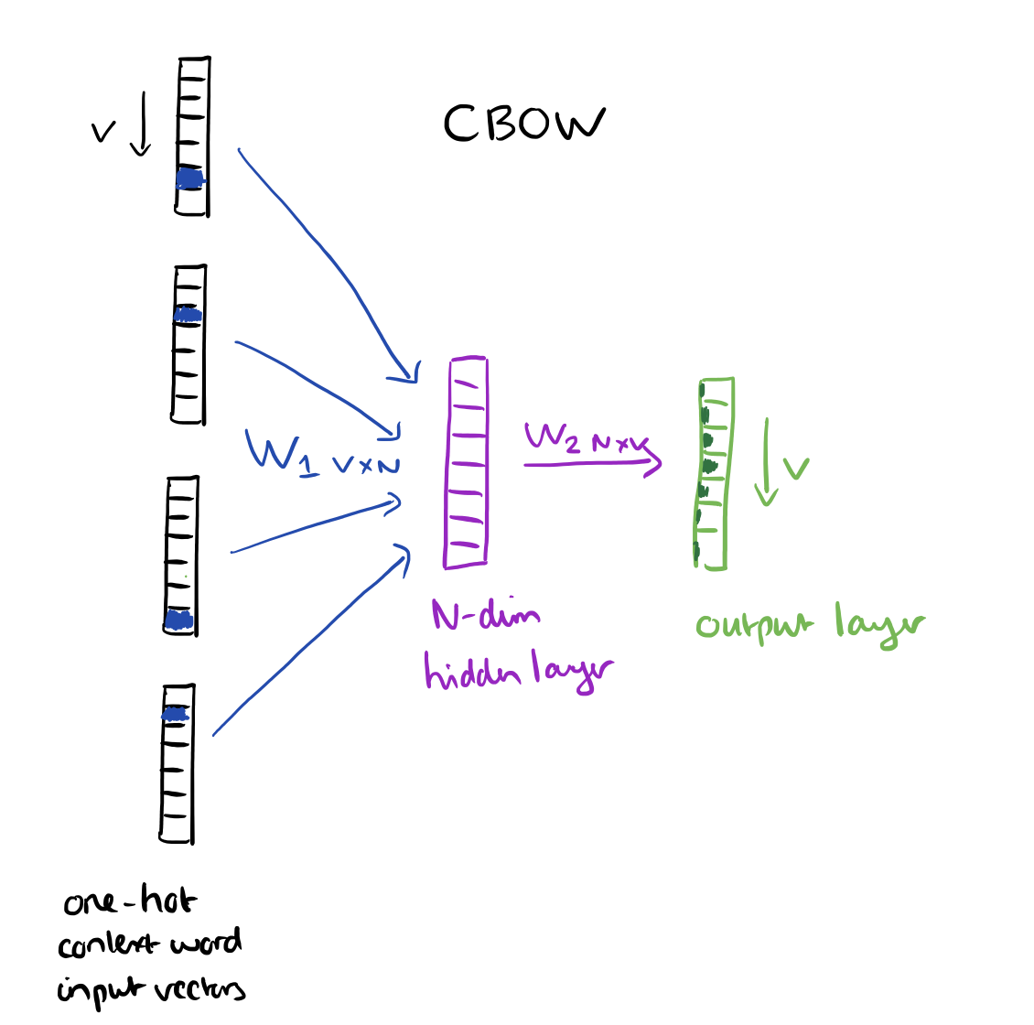

Slide 39
The core idea of CBOW is given context words ,it should predict the focus word.
We need to Train this CBOW:
Given repository of text create a dataset of focus words and context words.
Text : “The cat sat on the wall”
We can then train the CBOW Neural Network using this dataset.
Focus Words | Context Words
Sat | The,cat,on,the,wall
Cat | The,sat,on,the,wall
on | The,cat,sat,the,wall
The | Cat,sat,wall
Wall | The,cat,sat,on,the

Slide 40
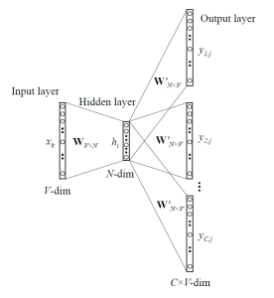
Skip Gram
Skipgram is just opposite to CBOW, in Skipgram we predict the context words given a focus word.
Here our input is a focus word and outputs are context words:

Slide 41
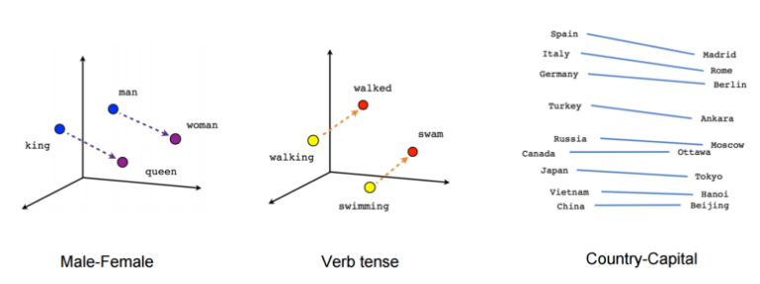
Word2Vec Features
If W1 and W2 are semantically similar then vectors V1 and V2 will be closer.
Word2Vec studies relationships,Word2Vec understands the relationship of Male gender word and female gender word, which means (Vman – Vwoman) || (Vking – Vqueen)

Slide 42
Word2Vec Functionality
Word2Vec learns all this relationships without being programmed to do so. It learns it automatically from Raw Text.
Vector can be chosen to be 50,100,200,300 dimensional.
Larger the dimensionality → More information rich the vector is.
Input: Large Text Corpus
Word2Vec
Output: Vector for Word

Slide 43
Using pre-trained word vectors
We will use google’s pretrained model.
It contains vectors for a vocabulary of 3 million words trained on around 100 billions words from the google news dataset.
Let’s see the code for this.

Slide 44
Training own Word2Vec
We will be training our own Word2Vec on a custom corpus.
For training the model we will be using genism.
Lets see the code.

